Slide 1

TRIBHUVAN UNIVERSITY
INSTITUTE OF ENGINEERING
CENTRAL CAMPUS PULCHOWK
DEVELOPMENT OF FLOW VISIUALIZATION AND INSTRUMENTATION SYSTEMS FOR OPEN CIRCUIT SUBSONIC WIND TUNNEL AND THEIR VALIDATION WITH EXPERIMENTS ON NACA 0012 AIRFOIL
Presented by
Yubraj Kawar (072/BME/647)
Yugal Krishna Shrestha (072/BME/648)
Saman Dhakal (072/BME/651)
Presentation on
Final year project
JULY 2019

Slide 2
OUTLINE OF THE PRESENTATION
Introduction
Project Objectives
Methodology
Flow visualization
Simulation
Instrumentation
Experimentation
Comparison
Future works and recommendations
conclusions
References

Slide 3
INTRODUCTION
Wind tunnel
Flow visualization
Instrumentation
Simulation
Experimentation
Comparison

Slide 4
PROJECT OBJECTIVES
Main objective
To develop proper flow visualization and instrumentation techniques for open circuit subsonic wind tunnel
Specific objectives
a) To design and fabricate the system for mounting wing section into an open circuit wind tunnel test section.
b) To setup an instrumentation system for acquiring real-time lift and drag forces from the wing section.
c) To develop a technique for flow visualization over the wing section.
d) To compare the numerical data obtained from experiment with computationally simulated result.

Slide 5
METHODOLOGY
Literature review
Designing, material selection and manufacturing
Visualization
Instrumentation and experimentation
Result comparison
Simulation and analytical analysis
Conclusions and references

Slide 6
WIND TUNNEL
Dimensioning and production of a 3D design of wind tunnel in a CAD software.
Measurement of airspeed in the wind tunnel.
Design and fabrication of setup of mountings.

Slide 7
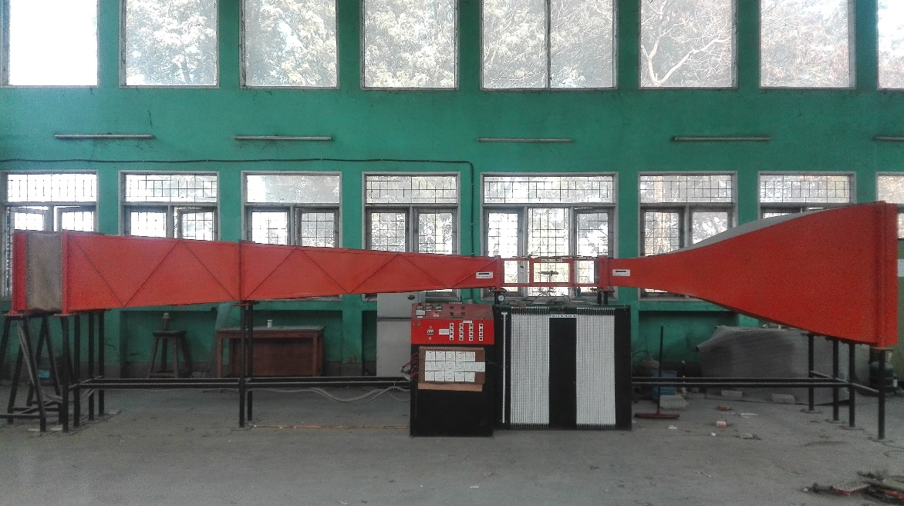
WIND TUNNEL cont.
Picture of wind tunnel
Diffuser
Test section
Contraction

Slide 8
WIND TUNNEL cont.
S.N. | Section | Dimension(mm)
1. | Contraction | 1200×1200
2. | Test section | 250×250
3. | Diffuser | 650×650
Number of fans | 16
Rated input power | 1400 watt
Rated output power | 500 watt

Slide 9
WIND SPEED MEASUREMENT cont.
Number of fans turned on | Air speed(m/s)
1 | 0.00
2 | 1.3
3 | 2.18
4 | 3.05
5 | 3.40
6 | 4.10
7 | 5.01
8 | 5.88
9 | 6.74
10 | 7.60
11 | 8.55
12 | 9.48
13 | 10.35
14 | 11.01

Slide 10
Mounting Setup

Slide 11
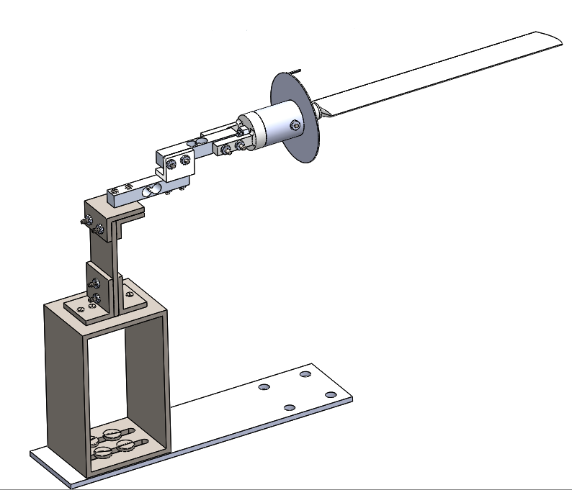
Mounting setup
Wing section
Wing holder
Drag Load cell
Drag Load cell
Angle indicator
Fastener
Rectangular Base
Base for setup

Slide 12
Main features of Mounting Setup
Allows for 360° rotation of test model.
Provides tolerances in X, Y and, Z direction during assembly.
CG lies in the rotation axis of wing so the moment due to self weight disappears.
Least count can be changed according to necessity.

Slide 13
Limiting Criteria for Material Selection

Slide 14
Material selection
S.N. | Components | Materials
1 | Load cells | Aluminum alloy
2 | Wing section | PLA
3 | Wing section holder | PLA
4 | Wing holder supporter | PLA
6 | Beam for holding setup | Iron
7 | Base for holding setup | Iron

Slide 15
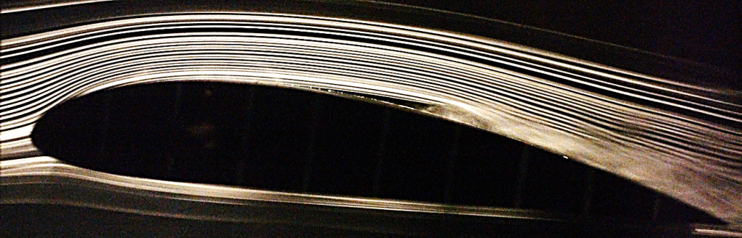
FLOW VISUALIZATION
Smoke visualization method
Smoke liberated from chemical reaction was introduced into the wind tunnel by virtue of suction of the fans of the wind tunnel itself.

Slide 16
FLOW VISUALIZATION cont.
Generation of smoke by help of chemicals.
The chemicals used for generation of smoke are potassium nitrate and table sugar. The reaction takes place as follows:
With excess of sugar,
5C₁₂H₂₂O₁₁ + 48KNO₃ = 24K₂CO₃ + 36CO₂ + 55H₂O + 24N₂
With excess of potassium nitrate,
C₁₂H₂₂O₁₁ + 24KNO₃ = 24KNO₂ + 12CO₂ + 11H₂O

Slide 17
FLOW VISUALIZATION cont.
Flow visualization using commercial system
Smoke fluid which was heated inside the smoke generator to produce the smoke.
50mW laser sheet with the wavelength of 515-532 nm was used for the planar flow visualization.
Mid-plane of the wing section was chosen arbitrarily to observe the flow pattern over the wing section at different angles of attack.
The images were captured using a 12MP camera embedded in iPhone 6s.

Slide 18
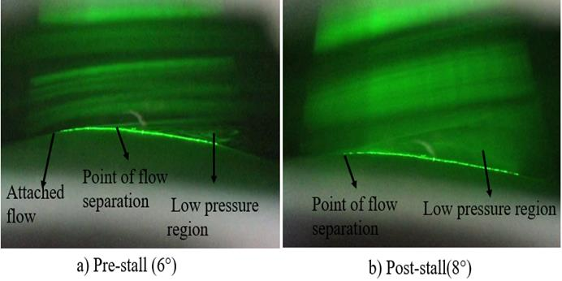

Slide 19
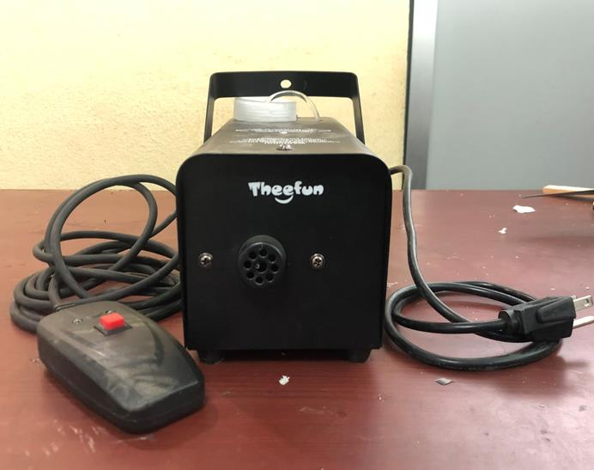
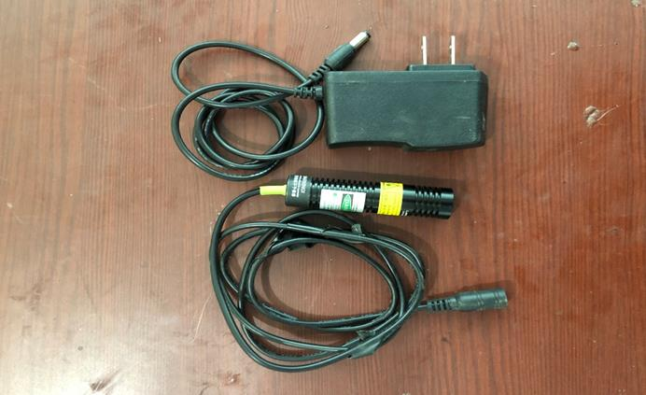
Smoke generator
515-532 nm laser

Slide 20
INSTRUMENTATION

Slide 21
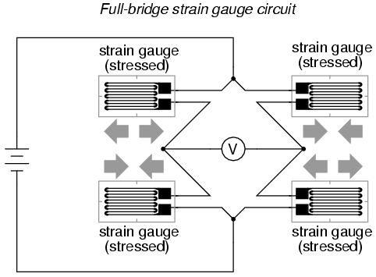
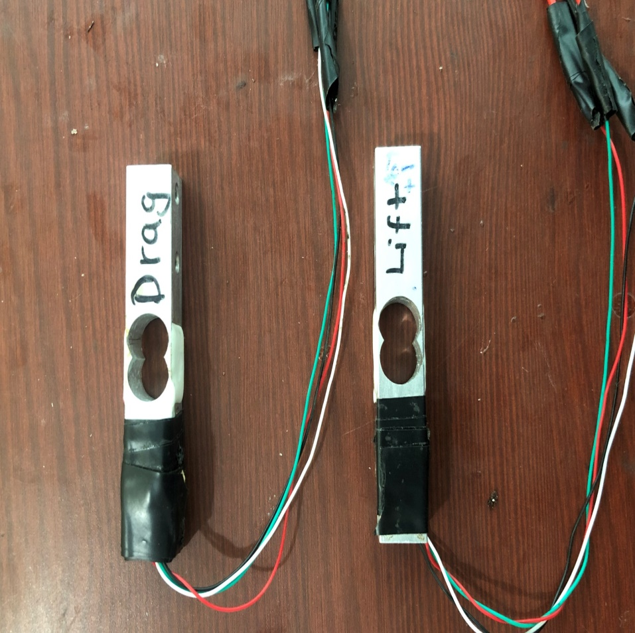
Full Wheatstone bridge configuration of load cell (Source: Libretext)
Load cells used in the setup

Slide 22
INSTRUMENTATION
Calibration of load cell for lift
Five-point calibration was carried out
The sample data were recorded at the rate of 1000 per second for at least 20 seconds for each weight.
The weights were plotted against the mean of these samples taken in the first 20 seconds.
Calibration constant, standard deviation for each weight, and R-squared value of the weight-voltage curve was determined using Excel.

Slide 23
Lift calibration
Known weights (N) | Mean Voltage (Volts) | Standard deviation (V)
0 | 1.46 | 0.055563072
0.996696 | 1.29 | 0.05440951
2.003202 | 1.12 | 0.053967849
3.0171636 | 0.93 | 0.055333542
4.1570856 | 0.77 | 0.053015485
5.1552531 | 0.56 | 0.056964915
Lift calibration
Lift calibration plot

Slide 24
Lift calibration plot
The calibration constant for lift was -5.7964 N/V.
R² value was 0.9983.
99.83% of the data are accurately predicted by the least-squares regression line (the dotted line).
The load cell exhibits a linear behavior in its operating range.

Slide 25
INSTRUMENTATION
Calibration of load cell for drag
Done similarly as lift load cell.
Five-point calibration was carried out.
The sample data were recorded at the rate of 1000 per second for at least 20 seconds for each weight.
The weights were plotted against the mean of these samples taken in the first 20 seconds by DAQ.
Calibration constant, standard deviation for each weight, and R-squared value of the weight-voltage curve was determined using Excel.

Slide 26
Drag calibration
Known weights (N) | Mean Voltage (Volts) | Standard deviation (V)
1.13 | 0 | 0.050163571
0.97 | 0.996696 | 0.058484209
0.8 | 2.003202 | 0.050079413
0.63 | 3.0171636 | 0.049518299
0.44 | 4.1570856 | 0.050162443
0.27 | 5.1552531 | 0.04645669
Drag calibration
Drag calibration plot

Slide 27
Drag calibration plot
The calibration constant for drag was -5.9874 N/V.
99.99% of the data are accurately predicted by the least-squares regression line.
The load cell exhibits a linear behavior in its operating range.
The operating range being 0–1 kg.

Slide 28
Data acquisition

Slide 29
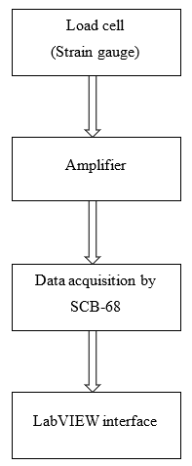
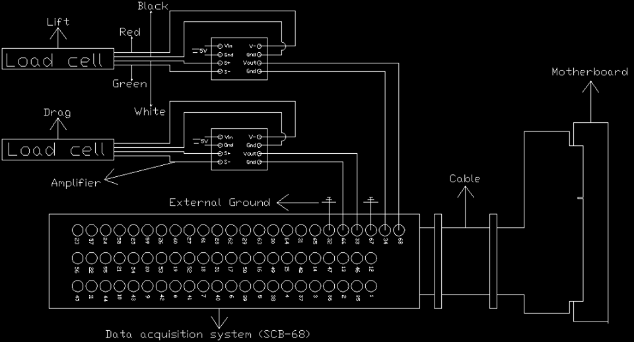
Data acquisition
Data acquisition process
Circuit diagram for data acquisition process

